Slide 1
INTERMEDIATE & SENIOR PARENT MEETING

Slide 2
Welcome to Starskate INTERMEDIATE & Senior Programming
Your skaters are able to follow the Starskate or Podium Pathway
Depending on your skating level you are in the learn-to-train or train-to-train level of Sport for Life Long-Term development in Sport
When logged into your account with Skate Canada you can read more on Pathway choices
If you have not already, go to skatecanada.ca/members to create an account in your child’s name. This way you will be able to see their STARskate Achievements and follow their official progress.

Slide 3
Assessments
REMINDER
If paying by CASH, you are still required to create and invoice and purchase the assessment on-line. Choose e-transfer and we will modify with receipt of payment
INCLUDE SKATERS NAME AND ASSESSMENTS TAKING ON YOUR INVOICE
INCLUDE INVOICE NUMBER ON YOUR ENVELOPE PROVIDED BY THE COACH

Slide 4
Events
2024 PEI Fall Invitational for Star 1 – 4 & Synchro 1 – 4 November 16, 2024 Cody Banks Arena
Discuss with coaches your plan of events for the season
Registrations start early
Competition funding of $100 for one off-island event is available for Starskater. Payable after the event
Go to “links gotta see it info” on our home page for a list of events

Slide 5
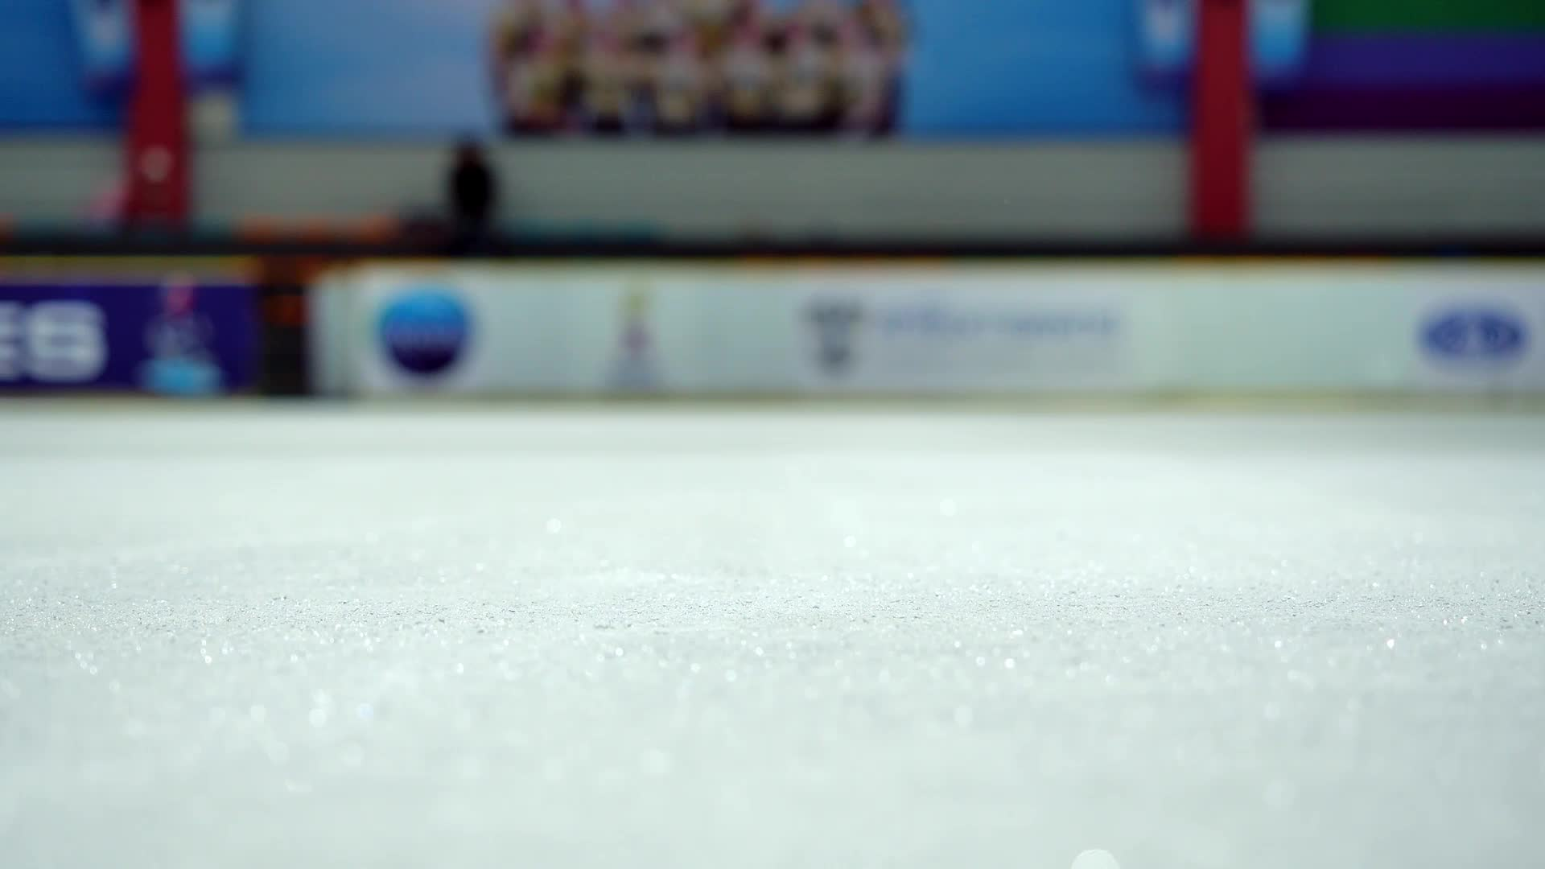
Competition Hosts
Sherwood Parkdale Skating Club is part of the Island Skating Academy for programs in the off-season.
We will be hosting the 2024 PEI Fall INVITATIONAL as well as the 2025 Starskate and Synchro Championships with Skate Canada PEI.
For the Fall Competition we have more responsibilities and duties to cover as volunteers.
COLLEEN MURRAY WILL BE OUR Coordinator WITH isa and will be the lead for our club along with Laurie Godfrey (for ISA &the PEI Section). CSC WILL HAVE A representative AS WELL AS PART OF isa
more INFORMATION ON HOW YOU CAN HELP WILL BE PROVIDED AFTER isa MEETS

Slide 6
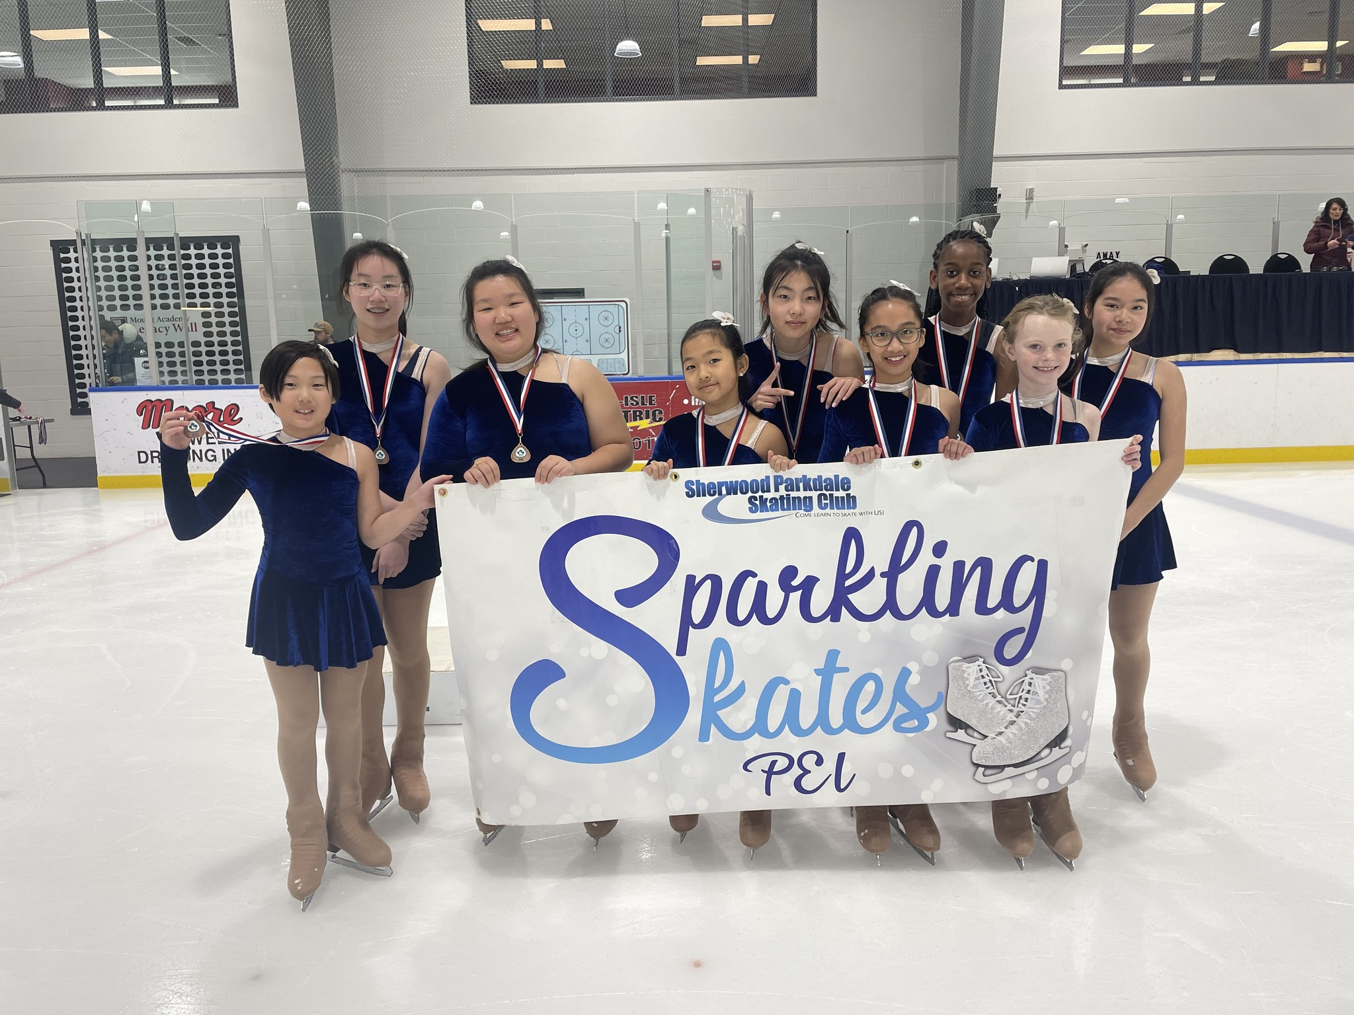
Synchro
All STARSKATERS are encouraged to take part in Synchro
As part of the Skate Canada curriculum, this session is an excellent opportunity to develop skating skills
For the skater’s this is a great opportunity to engage in a team environment
The cost is $150 as an add-on to a Starskate Registration or we have a new part-time package.
BOTH include ice time, coaching, off-ice classes, the Team portion of competition registration fees
New team members will also receive a free Sychro Jacket
Toonie Days from September, popcorn sales at events plus any agreed upon fundraising goes into our Synchro fund to help off-set costs

Slide 7
Healthy Kids! Active Kids! Fundraiser
This season the fundraiser WILL BE PARTNERED WITH QUEEN STREET MEAT MARKET IN CHARLOTTETOWN
FUNDRAISING POLICY
If you want to fill your freezers and you purchase more than 10 items, you will receive a credit on your personal account as well as helping the club overall.
Hard copies and digital copies will be available
This is our main fundraiser for the club that puts food on tables at better than or equal to grocery store prices while helping the club keep fees affordable.

Slide 8
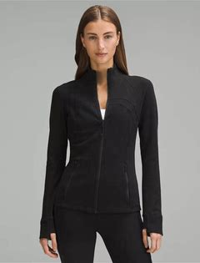
Team spirit
Club jackets are available to order. Your orders are Due by October 4th
Lululemon define jackets embroidered with the club logo and skaters Name or initials. Start at size 0
Great for both practice and competition
Youth sized are available by special order in a Lulu style jacket
Your cost: Lululemon $60 – 100 dependant on discount available: youth custom $40

Slide 9
How can you help your skater succeed
Encourage personal growth
Not to compare themselves with other skaters but use each other to motivate and support sportsmanship
Encourage proper etiquette on the ice. Respecting everyone’s right to train and not disrupt practice
Use their training time to the fullest
Recognize that there are entry levels throughout the stages of figure skating. Believe in themselves
Healthy Eating
Take advantage of opportunities outside of regular ice and off-ice times

Slide 10
NUTRITION

Slide 11
Terms and conditions
Signed when registering
You can also view by clicking on the link at the bottom of our home page

Slide 12
Key areas to review in your Terms and conditions
Policy links under Code of Conduct
Refunds & Credits
PA Incentive under Volunteers
Cancelations
If you haven’t reviewed, how can you follow?
Medical only once past the withdrawal date
No make-up or refunds for personal reasons ie holidays etc
Review if skater is moving up to Juniors or your skater is 10yrs and older
Notifications

Slide 13
Program assistants AND THE STARSKATE PROGRAM
Jumpstars
Intermediates
Seniors
No PA’ing
Juniors
10 yrs and up
10 yrs and up
Intro to PA’ing levels
All ages; no minimum age
Training twice a year
Did you know that your Starskate Progams cost up to 3 times as much as charged
The PA Incentive helps us keep your fees down

Slide 14
Lead by example
Our club….Your Club….is a community.
Starskaters assist as program assistants on Canskate
We need you, the adults also. You can sit on the board and learn more about your child’s sport and program, you can help at events, you can help on theme days. Consider joining us today in anyway you can.

Slide 15
Reminders
THE CALENDAR tab in your account
will show all your registered skating days, events etc.
This is the best “go-to”. It the event of any changes, it will show here first.
Off-ice classes are included in your registration and an important part of a skater’s training. If possible ,please bring a yoga mat, skipping rope, running shoes and a water bottle. A “spinner” is also very useful.

Slide 16
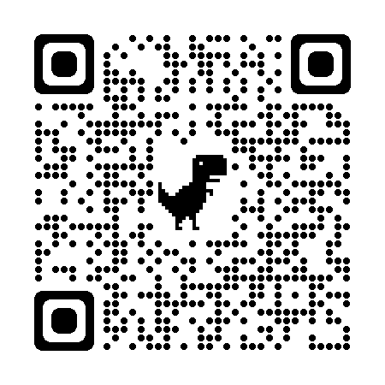
Club Apparel
We have a store available through Allstar Cresting
There are leggings, t-shirts, hoodies, outdoor jackets and more – Get in the spirit with quality merchandise. 10% goes to the club.
https://allstarcresting.ca/
Mittens and gloves as well as skate guards are also still available in our club office or lobby when on display

